Slide 1
Zephyrus Hand Motion-Controlled Remote Car
Analysis
Embedded Systems
Hugo Carvalho – A85156
José Mendes – A85951

Slide 2
Agenda
Problem Statement
Market Study
Requirements
Constraints
System Overview
Hardware Architecture
Software Architecture
Reinforcement Learning
Events
Uses Cases
Sequential Diagrams
State Diagrams

Slide 3
Problem Statement
Motion-tracking and gesture-controlled robots have been gaining traction in entertainment and medical applications.
In an R&D-like approach, the project will consist of a gesture-controlled car with a wristband as a remote controller.
The user will be able to accelerate and steer the vehicle using natural wrist and finger movements.

Slide 4
Problem Statement

Slide 5
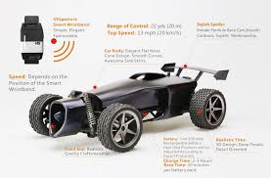
Market Study
Ultigesture’s arm gesture-controlled RC car
Cost: 89$
Pros:
Practical setup;
Appealing design;
The use of Bluetooth allows the car to be controlled both by arm gestures and smartphone;
Cons:
Unpractical and uncomfortable to command.
Glove-controlled RC Quadcopter Drone
Cost: 36$
Pros:
Practical and comfortable to command;
Impactful first impression;
Cheap;
Cons:
Cheap-feeling;
Can only be worn in the right hand.

Slide 6
Added Value
Zephyrus aims for:
Good usability;
Competitive pricing;
An easy setup;
Comfortable use and control.

Slide 7
Requirements
Functional Requirements:
Sense the user inputs and generate the band outputs;
Take the wristband inputs and generate the desired motor outputs;
Use wireless communication between the local and remote systems;
Control the establishment and closure of the connection from the remote system.
Non-Functional Requirements:
Have low power consumption;
Have low latency in the connection between local and remote;
Have a comfortable and practical wristband/glove.

Slide 8
Constraints
Technical Constraints:
Use the Nucleo-STM32F767ZI as the development board;
Use at least three different types of sensors;
Use FreeRTOS as the RTOS;
Use a controller based on Reinforcement Learning following the Actor-Critic method;
Use Keil MDK-ARM as the development environment;
Use Object-Oriented Programming Languages;
Non-Technical Constraints:
Project deadline at the end of the semester;
Pair workflow;
Limited budget;

Slide 9
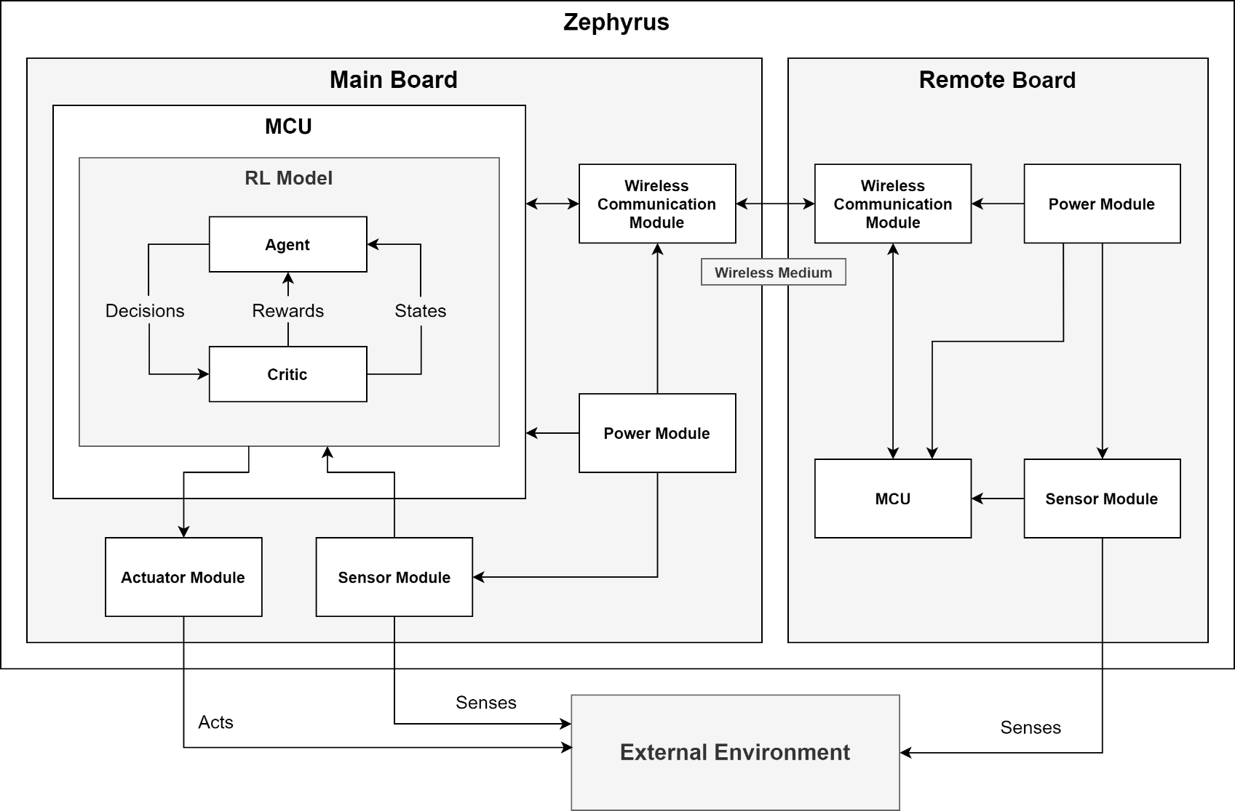
System Overview

Slide 10
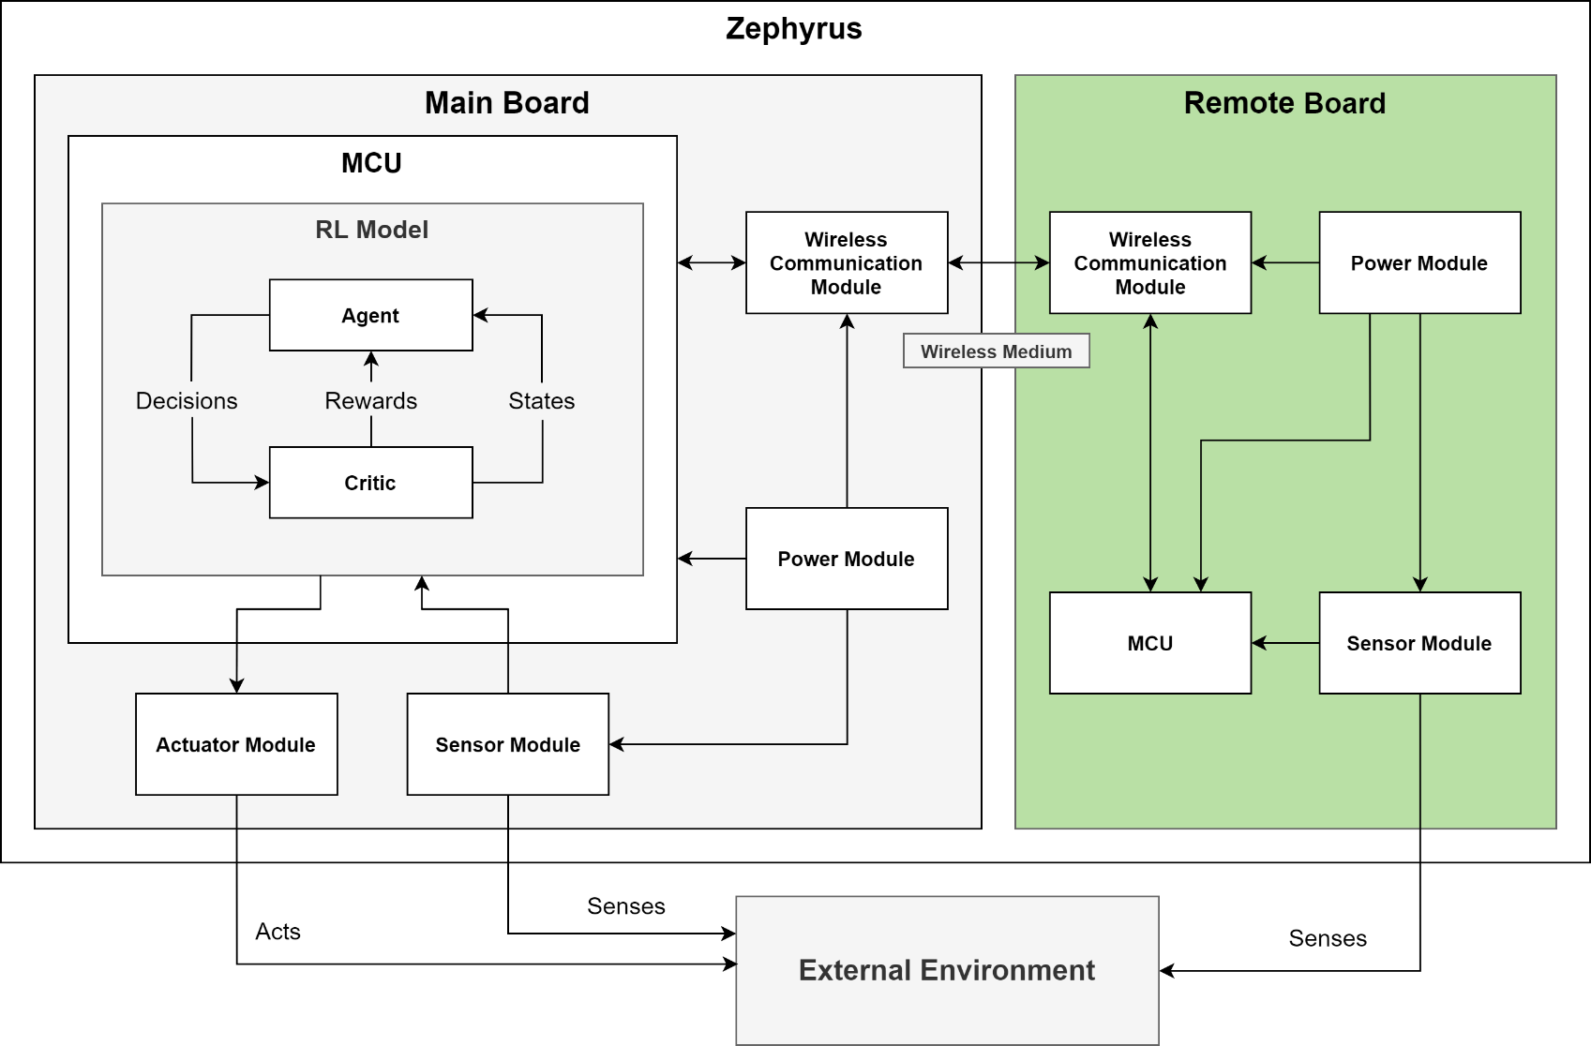
System Overview

Slide 11
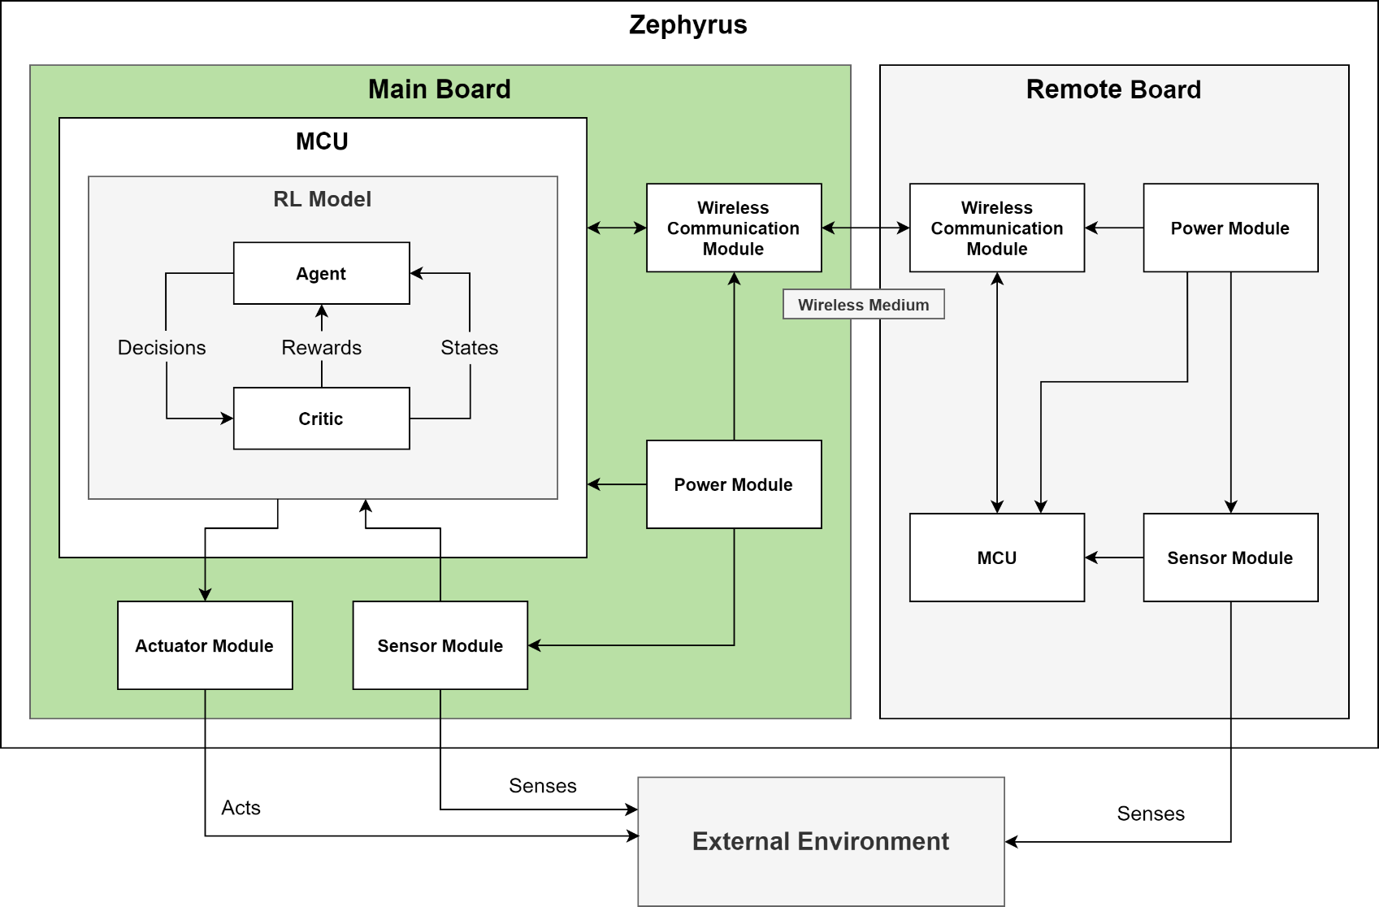
System Overview

Slide 12
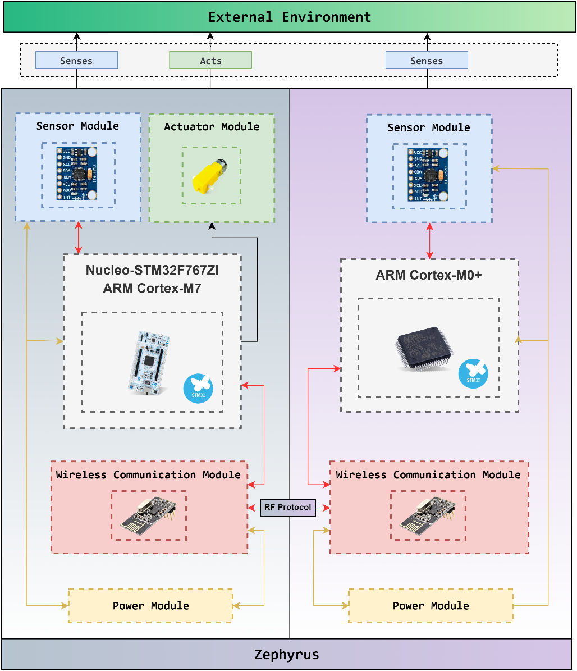
Hardware Architecture

Slide 13
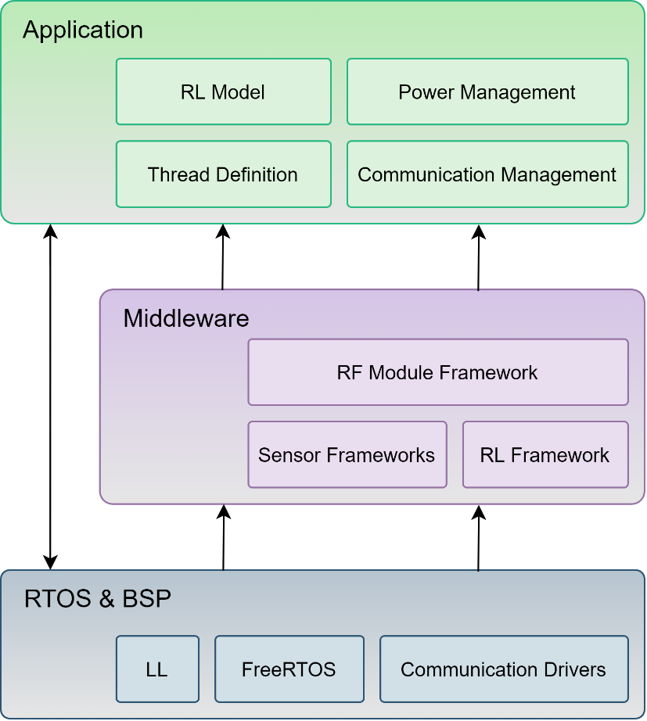
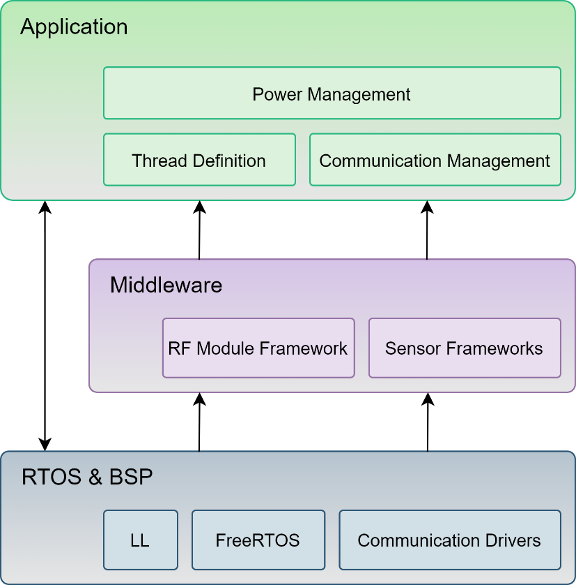
Software Architecture
Local System
Remote System

Slide 14
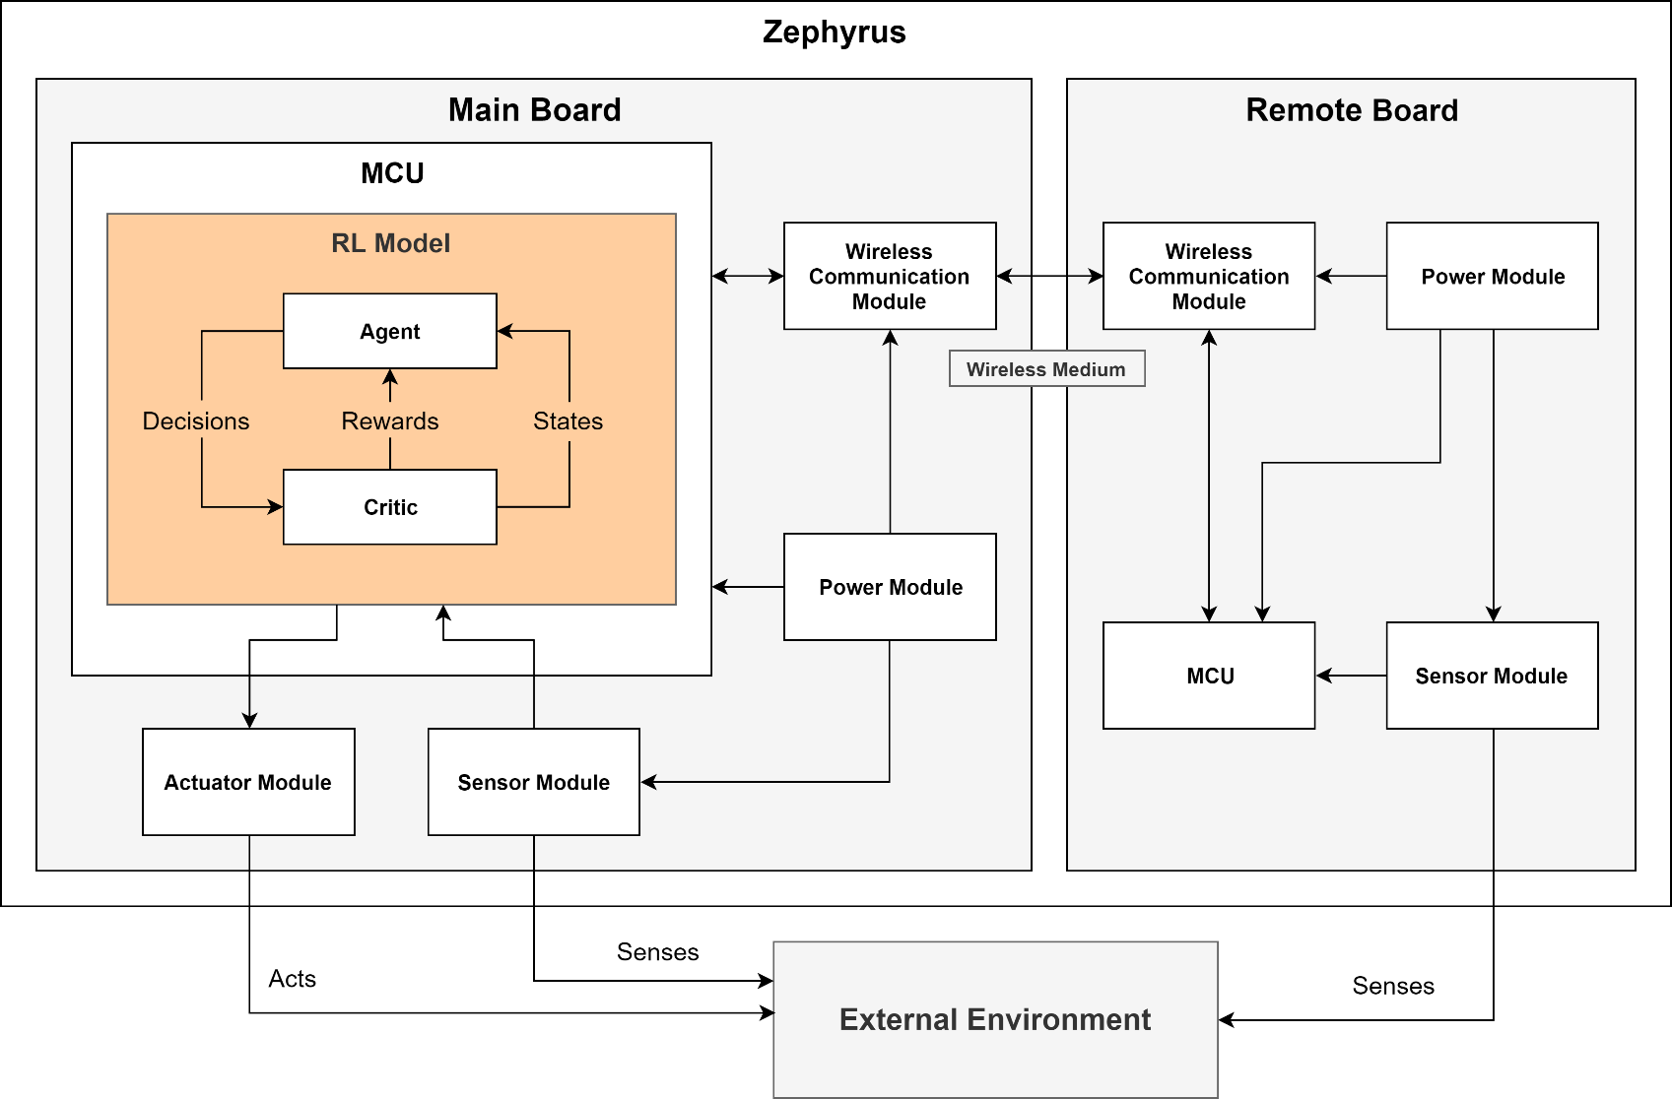
Reinforcement Learning
System Overview

Slide 15
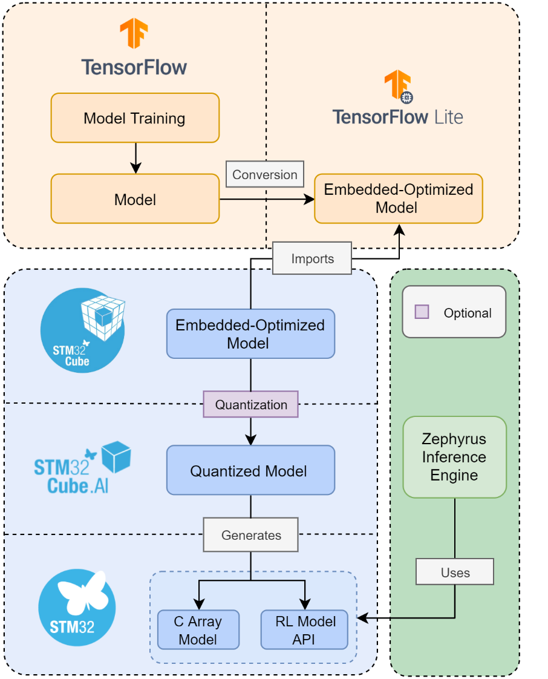
Reinforcement Learning
Zephyrus Edge Machine Learning Framework

Slide 16
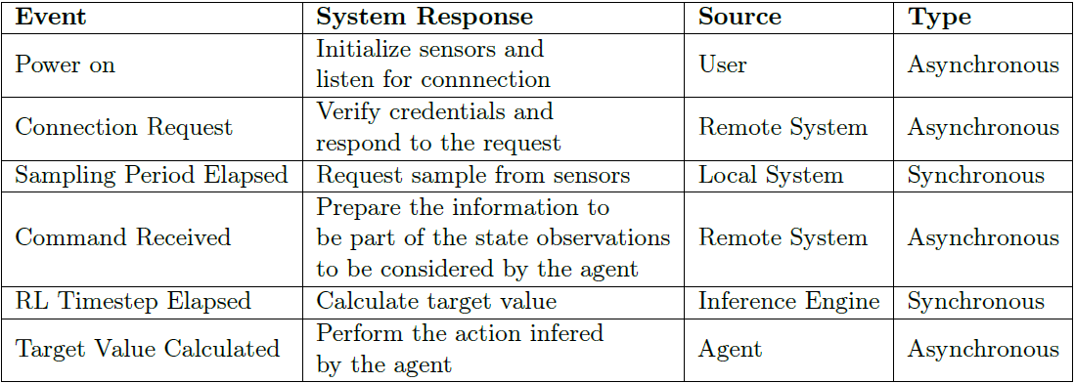
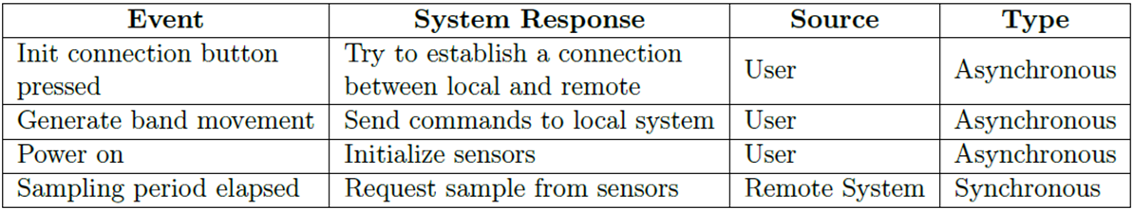
System Events
Local System
Remote System

Slide 17
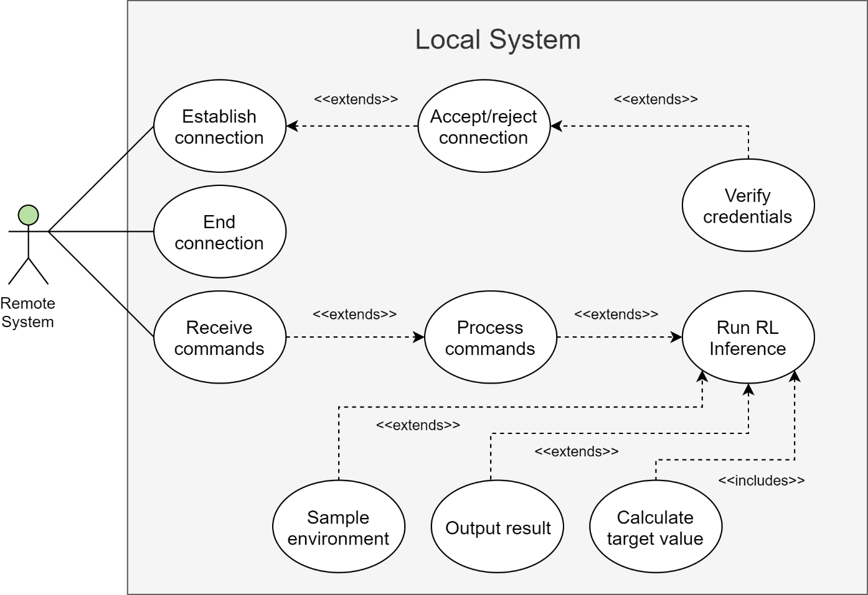
Local System Use Cases

Slide 18
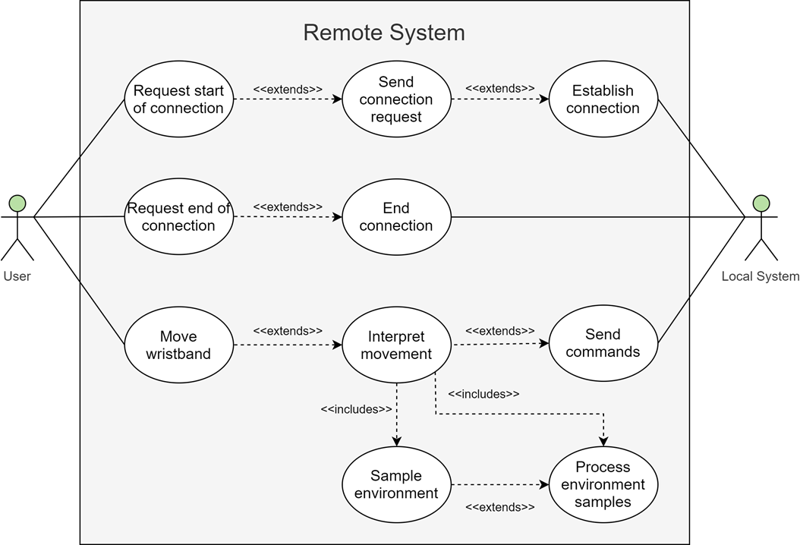
Remote System Use Cases

Slide 19
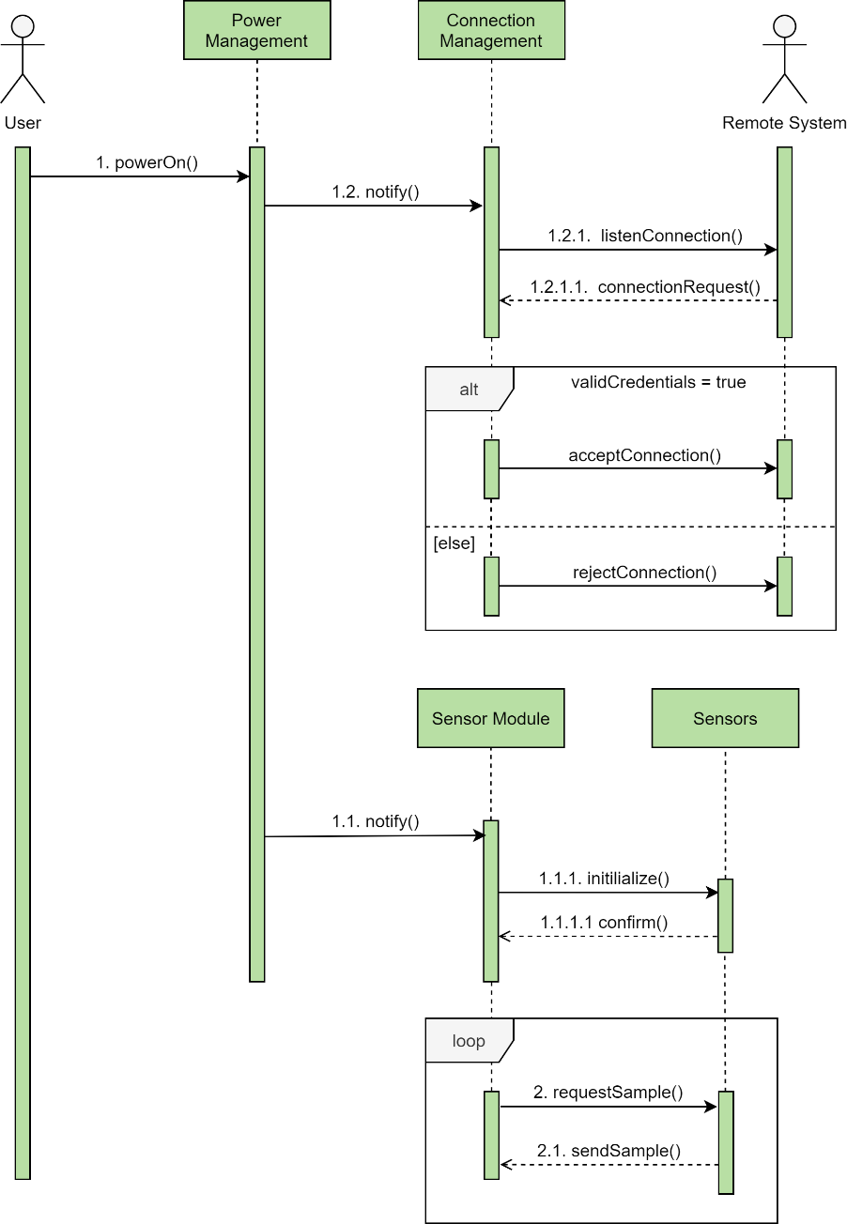
Local System Sequence Diagrams

Slide 20
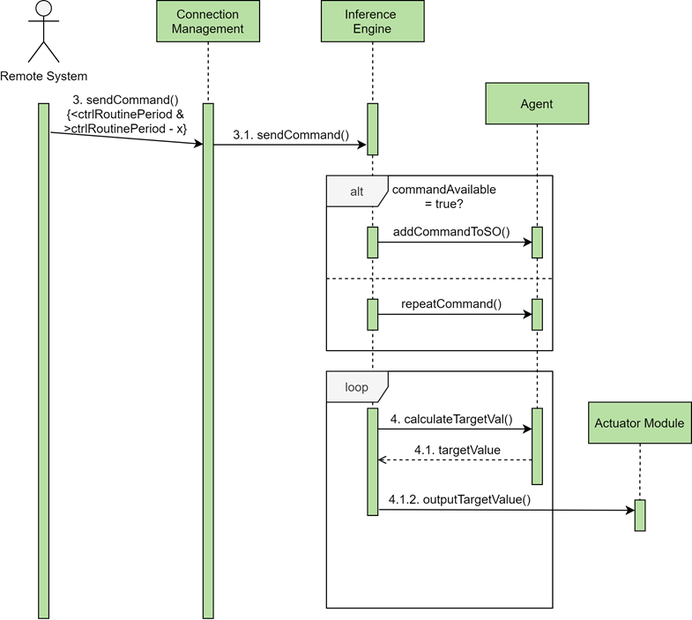
Local System Sequence Diagrams

Slide 21
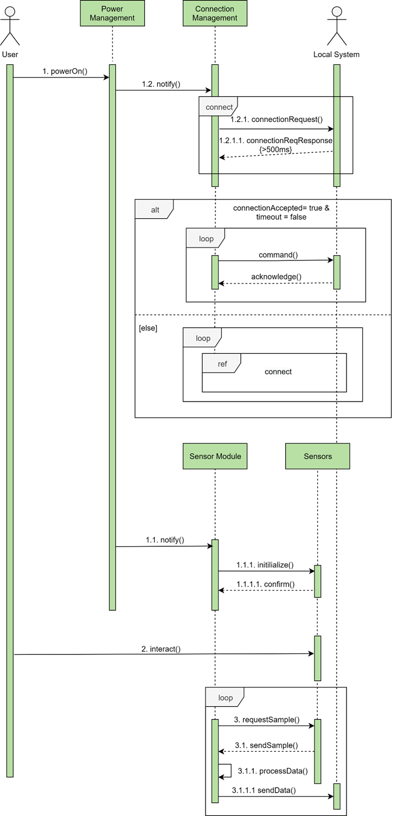
Remote System Sequence Diagram
1
1

Slide 22
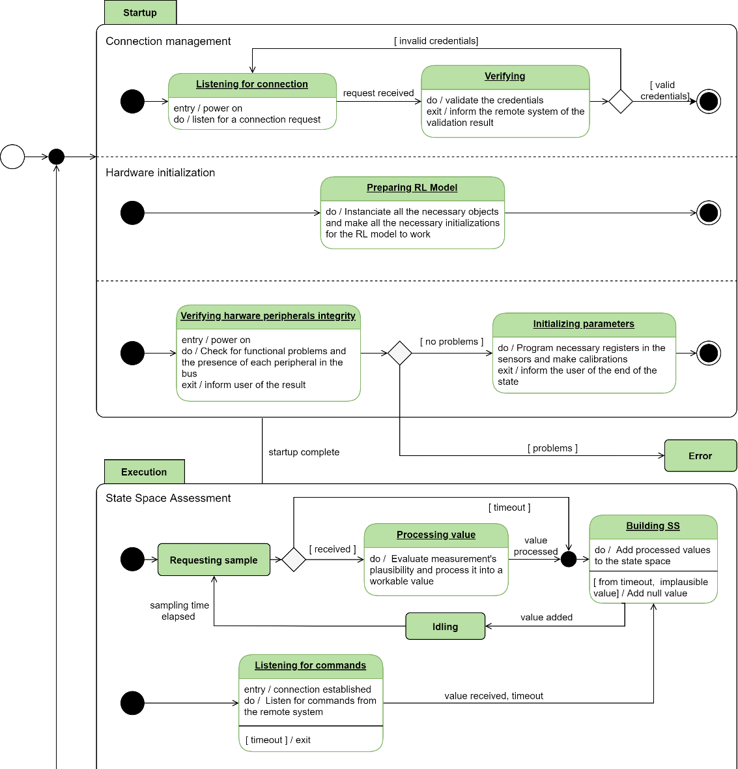
Local System State Diagram
2

Slide 23

Local System State Diagram
2

Slide 24
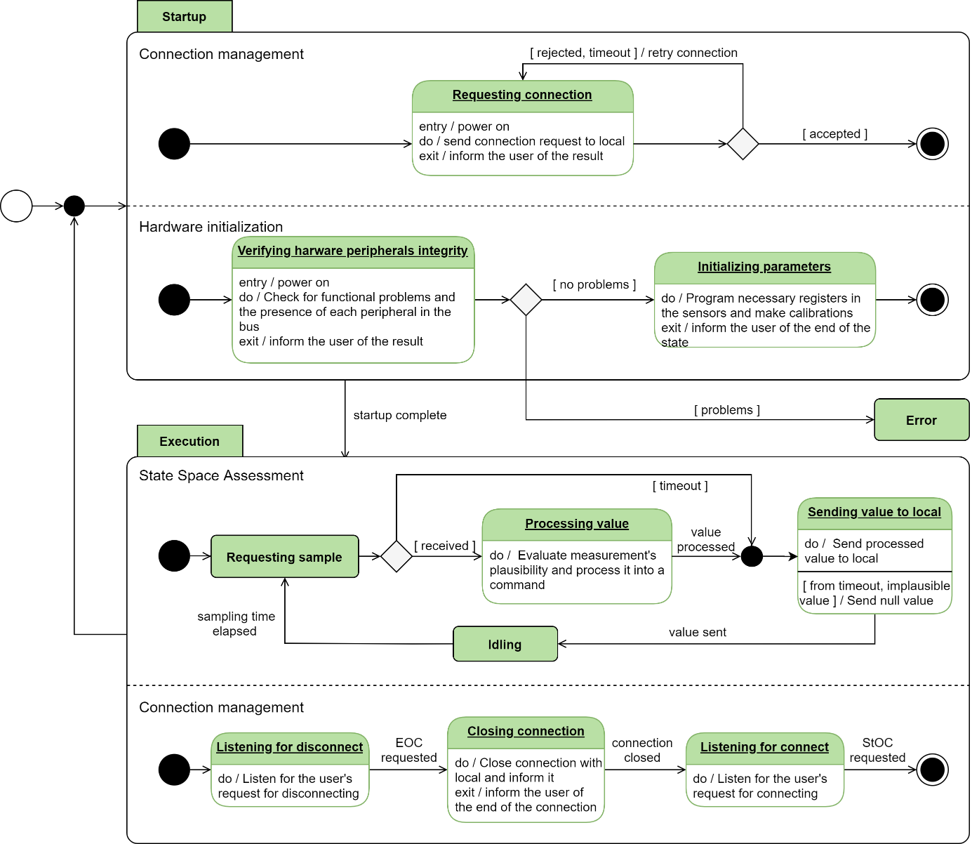
Remote System State Diagram

Slide 25
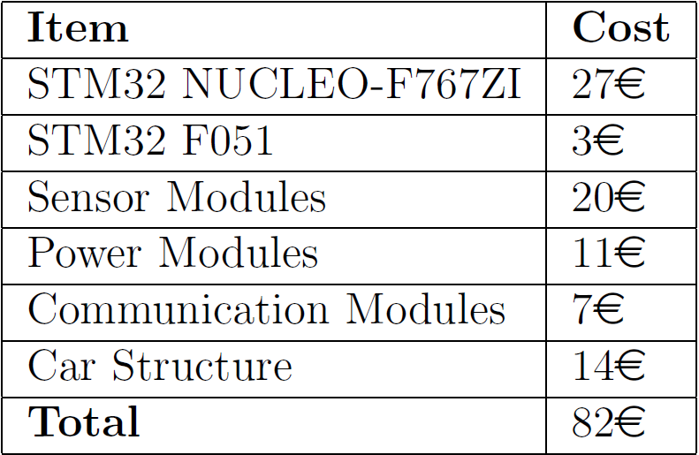
Estimated Budget

Slide 26
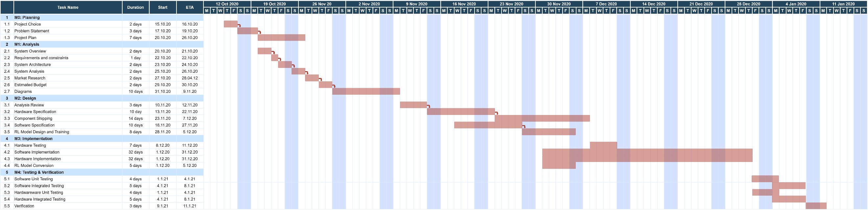
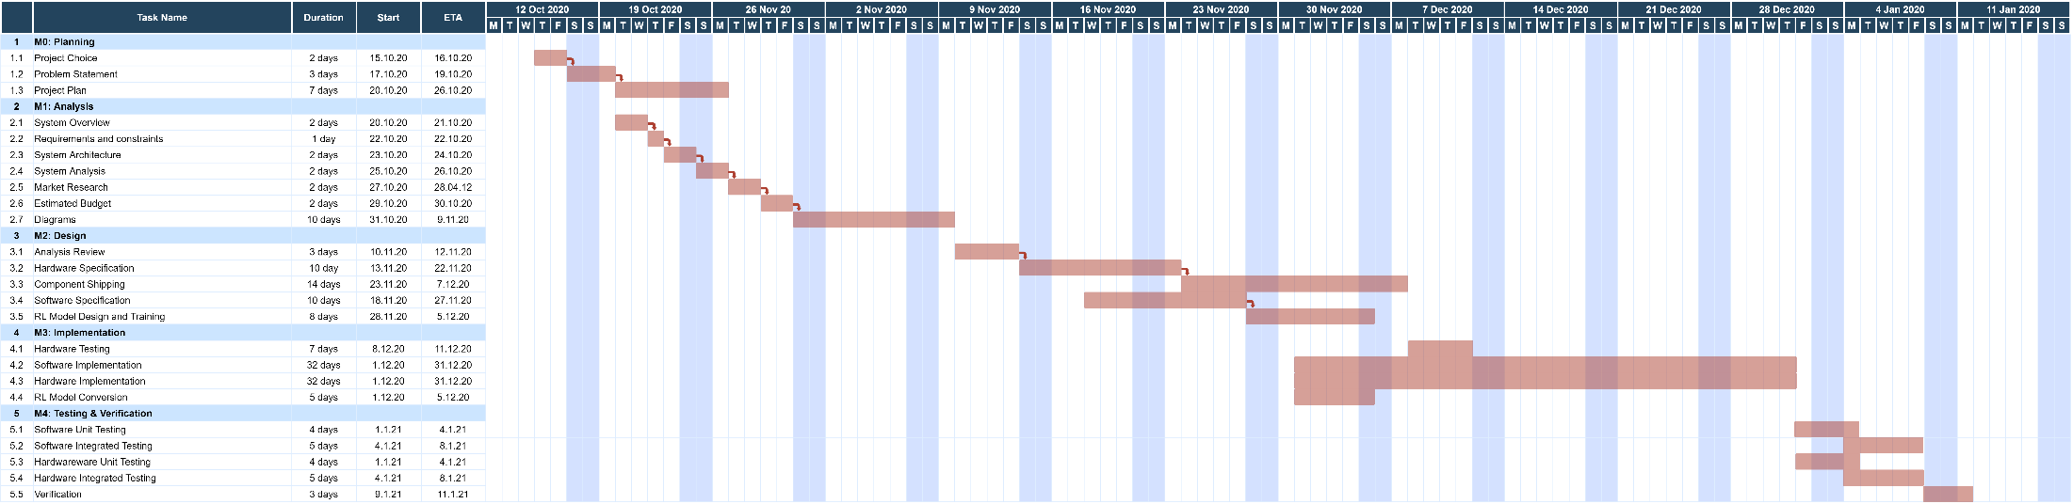
Gant Diagram

